Slide 1
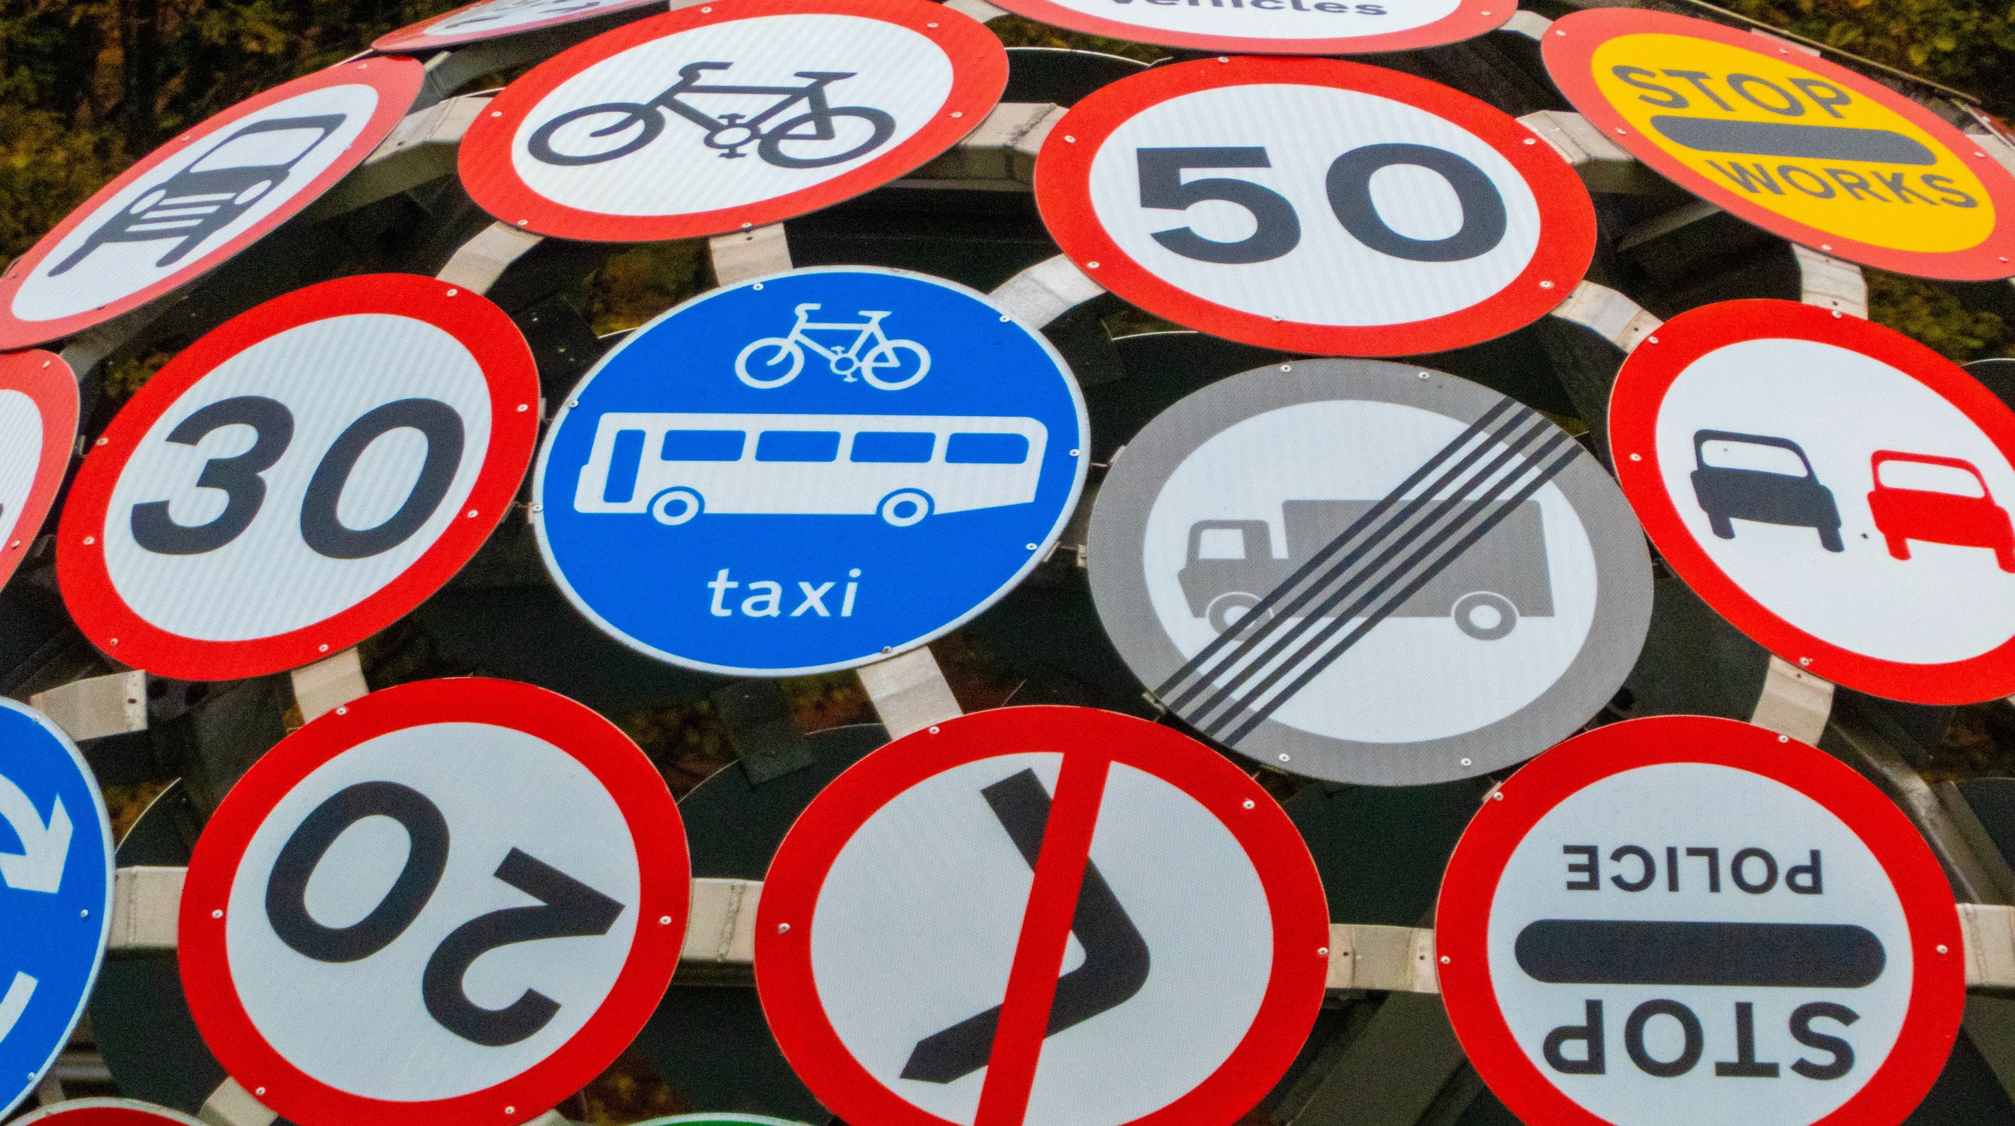
Traffic sign board detection -Using convolutional neural network

Slide 2
Objective:
The main objective of this project is to develop a robust and accurate traffic sign board detection system using Convolutional Neural Networks (CNNs) with the ultimate aim of improving road safety and traffic management.
The system will be designed to accurately detect and classify different types of traffic sign boards from images or video frames in real-time, even in challenging conditions.
The project seeks to leverage the power of deep learning to provide a practical solution that can be integrated into existing traffic management or driver assistance systems, allowing for better traffic flow, enhanced driver awareness, and improved compliance with traffic regulations. The system has potential uses in traffic monitoring, law enforcement, driver assistance, and urban planning, with the goal of making roads safer and more efficient for all road users.

Slide 3
Importance in current world:
Traffic safety = Traffic signal detection is an important aspect of ensuring road safety. Deep learning algorithms can be used to detect traffic signals accurately, which can help prevent accidents and improve overall traffic safety.
Autonomous vehicles = With the development of autonomous vehicles, traffic signal detection becomes crucial for these vehicles to understand and obey traffic rules. Deep learning algorithms can be used to enable autonomous vehicles to detect traffic signals and respond accordingly.
Smart city initiatives = Many cities are implementing smart city initiatives that leverage advanced technologies, including deep learning, to improve traffic management. Traffic signal detection can be a part of such initiatives to optimize traffic flow, reduce congestion, and enhance overall transportation efficiency.
Research and development = Traffic signal detection is an active area of research and development in the field of computer vision and deep learning. Researchers and practitioners may be working on traffic signal detection projects to improve the accuracy and efficiency of traffic signal detection algorithms.

Slide 4
Importance in current world:
Traffic management = Deep learning algorithms can be used to accurately detect traffic signals in real-time, allowing for efficient traffic management. For example, traffic signal detection can help optimize traffic flow by adjusting signal timings based on actual traffic conditions, reducing congestion and improving overall traffic efficiency. Digitalization of boards
Traffic data collection and analysis = Deep learning-based traffic signal detection can also be used for collecting traffic data, such as traffic volume, vehicle types, and traffic patterns, which can be analyzed to gain insights into traffic behavior and inform traffic planning and management decisions.

Slide 5
Understanding the Data:
The training data consists of 43 different types of sign board(43 folders) data in the image format
The training data consists of images captured in many kind of environment like different angles, different lighting conditions, clear and blurred, etc
For each sign board type separate folder is made and a unique number is giving

Slide 6
Understanding the Data:
0:'Speed Limit-20',
1:'Speed Limit-30',
2:'Speed Limit-50',
3:'Speed Limit-60',
4:'Speed Limit-70',
5:'Speed Limit-80',
6:'End of Maximum speed-80',
7:'Speed Limit-100',
8:'Speed Limit-120',
9:'No Passing (overtaking) for any vehicle
type except one line (track) transport
(like motorcycles and mopeds)',
10:'No passing for vehicles with a total weight
of over 3.5 t',
11:'Indicates priority only at the upcoming
intersection or crossing',
12:'Priority Road starts',
13:'Yield right-of-way',
14:'STOP',
15:'No entry for any type of Vehicle',
16:'No entry for motor vehicles with a
maximum authorized mass of more than 3.5 t',
17:'Do not enter',
18:'This is a general danger or warning sign.',19:'A single curve is approaching in the left direction',
20:'A single curve is approaching in the right direction'
21:'Indicates an approaching double curve - first to the left',
22:'Warning of a rough road ahead.',
23:'The danger of skidding or slipping.',
24:'he road narrows from the right side',
25:'Work in process',26:'Indicates the traffic signal ahead.',
27:'Pedestrian crossing ahead.',
28:'Pay attention to children ',29:'Be aware of cyclists',
30:'Beware of an icy road ahead.',
31:'Indicates wild animals may cross the road',
32:'End of all previously set passing and speed restrictions',
33:'Indicates that traffic must turn right',
34:'ndicates that traffic must turn left',
35:'The mandatory direction of travel is straight ahead. No turns are permitted',
36:'Mandatory directions of travel, straight ahead or right',
37:'Mandatory directions of travel, straight ahead or left',
38:'Prescribed drive direction around the obstacle. Drive from the right of the obstacle.',
39:'Prescribed drive direction around the obstacle. Drive from the left of the obstacle',
40:'Indicates entrance to a traffic circle',
41:'End of the no-passing zone for vehicles under 3.5 t',
42:'End of all passing (overtaking) restrictions'}

Slide 7
Steps :
Step 1 = Importing libraries required for the project
Step 2 = -Importing data folders
-extracting every images in the data one by one and resizing
the images into the size (32 X 32) and converting into array
format
Step 3 = Splitting Train and test data
Step 4 = Building a sequential model using Convolution Neural Network

Slide 8
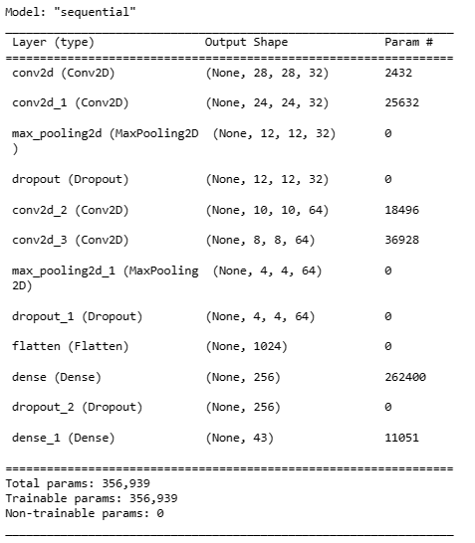

Step 4 =
Building a sequential model
using Convolution Neural Network
creating labels for y_train and y_test
from 0 to 43 for multiclass classification

Slide 9
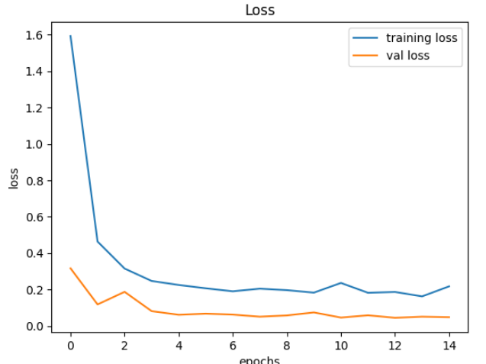
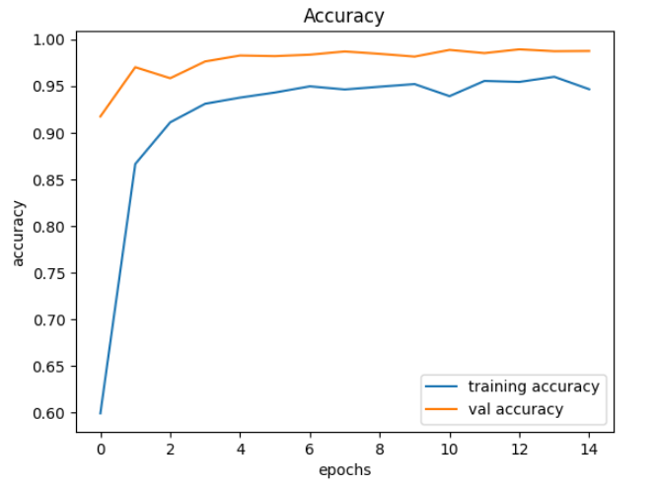
Step 5 =
Selecting best number of epochs where training and testing accuracies are close and loss is low
training and testing accuracies are close around the 13 to 15 epochs and loss is also low
So 15 epochs yields a general model

Slide 10
97.8% Accuracy achieved at 15th epochs
Step 6 = Selecting random test images from test data and predicting the output

Slide 11











Some predictions from the model :

Slide 12

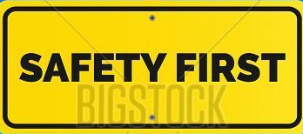
Thank you..

